Slide 1







Data Analysis Capstone Project
Fotis Tasioulis
5/6/2021

Slide 2



OUTLINE
Executive Summary
Introduction
Methodology
Results
Visualization – Charts
Dashboard
Discussion
Findings & Implications
Conclusion
Appendix

Slide 3

EXECUTIVE SUMMARY
Analysis and investigation of emerging skills and technologies in IT industry.
The objective is to identify emerging trends in IT sector in terms of:
Programming languages
Databases
Software platforms
Webframes
Survey conducted for developers around the globe to gather technology usage data.
The focus of the investigation was in current, future technology and demographics.

Slide 4

INTRODUCTION
Identify trends of different tools and platforms for IT professionals.
Target – Help IT professionals and recruiters stay on track with changing technologies and remain competitive by examining future expectations.
The investigation provides information about:
Top programming languages in current and next year
Top databases in current and next year
Top skills and training for development in the future.

Slide 5

METHODOLOGY
Collection of data
GitHub job postings
Stack overflow survey
IBM website
Data exploration and wrangling
Find and removed duplicates
Find and removed missing values
Normalizing data
Correlation
Outliers
Distribution
Data visualisation
Visualised distribution of data
Relationship
Composition
Comparison
Dashboards Creation
Used Cognos Analysis
Notes:
For the collection of data for the technology skills that are in demand different sources have been used like.
Preparation of the collected data by applying data wrangling techniques.
Analysis of the data by applying statistical techniques for the identification of insights and trends.
Use of data visualisation to effectively reveal findings and trends.
Use of Cognos for the analysis and presentationj of data dynamically.

Slide 6
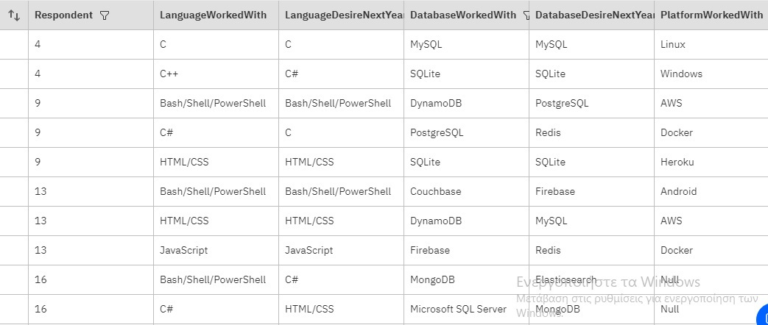
RESULTS

Slide 7
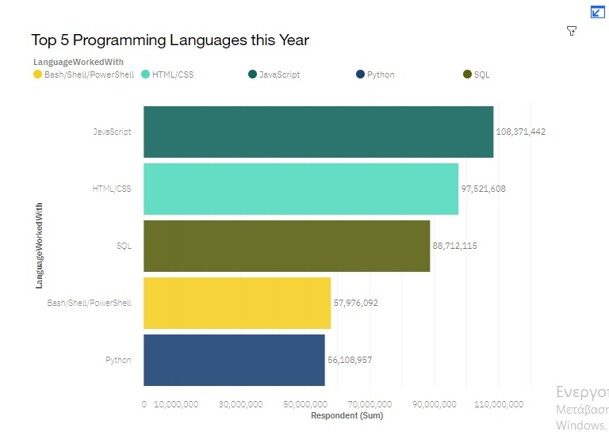
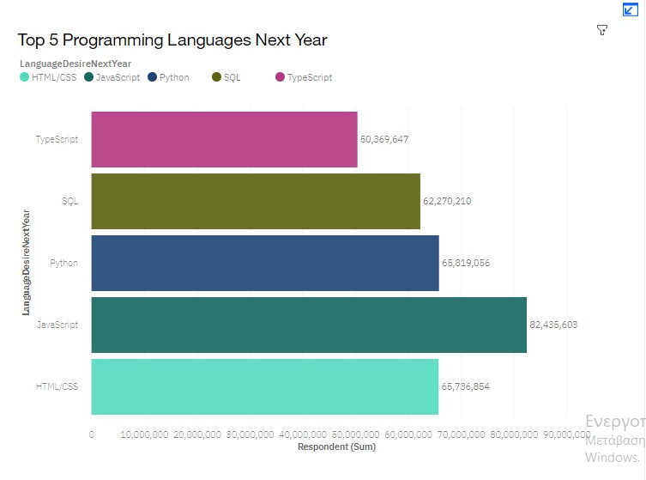
PROGRAMMING LANGUAGE TRENDS

Slide 8
PROGRAMMING LANGUAGE TRENDS - FINDINGS & IMPLICATIONS
FINDINGS
JavaScript and HTML/CSS have the biggest demand.
There is an increase in learning Python.
Bash/Shell/PowerShell will not be in high demand next year.
There will be a need in the future for TypeScript programming language.
IMPLICATIONS
Java and HTML should be a priority for IT professionals.
Learning Typescript will be a significant advantage for future careers.

Slide 9
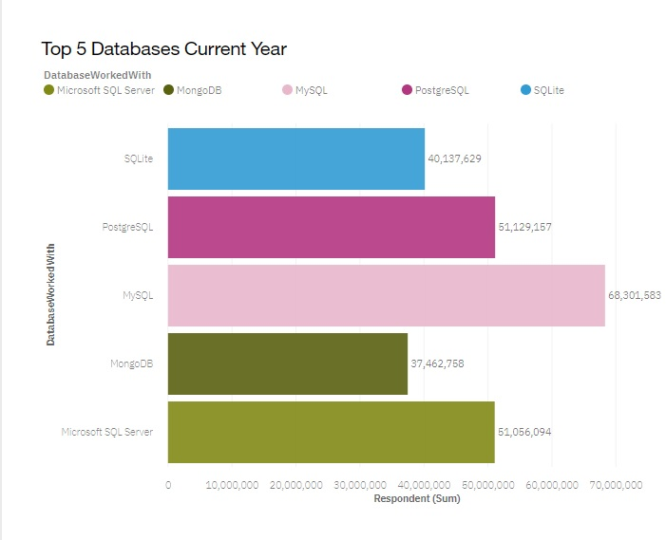
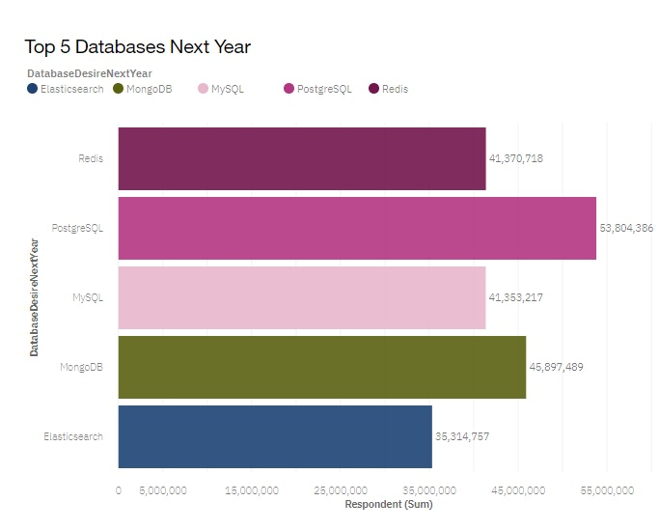
DATABASE TRENDS

Slide 10
DATABASE TRENDS - FINDINGS & IMPLICATIONS
FINDINGS
MySQL and MicrosoftSQL Server have the highest demand.
PostgreSQL is a widely used database.
The need for MongoDB database knowledge significantly increases in the next year.
Redis database will be in demand next year.
IMPLICATIONS
PostgreSQL,MongoDB and MySQL skills and training will be needed for professionals and IT sector to keep up with the trends.
Elasticsearch database will be used next years.
There is a preference in the IT sector for open source databases.

Slide 11

DASHBOARD
<https://eu-gb.dataplatform.cloud.ibm.com/dashboards/57944ccf-e5b9-47f2-a885-ef66c839bcce/view/4e07c47e0ebf6ed364c7b5e407912d037935245fb1bb8356d1847b495d642597f0681392c82d4d098e120731f5bf475fce>
Notes:
Dashboard permanent link.

Slide 12
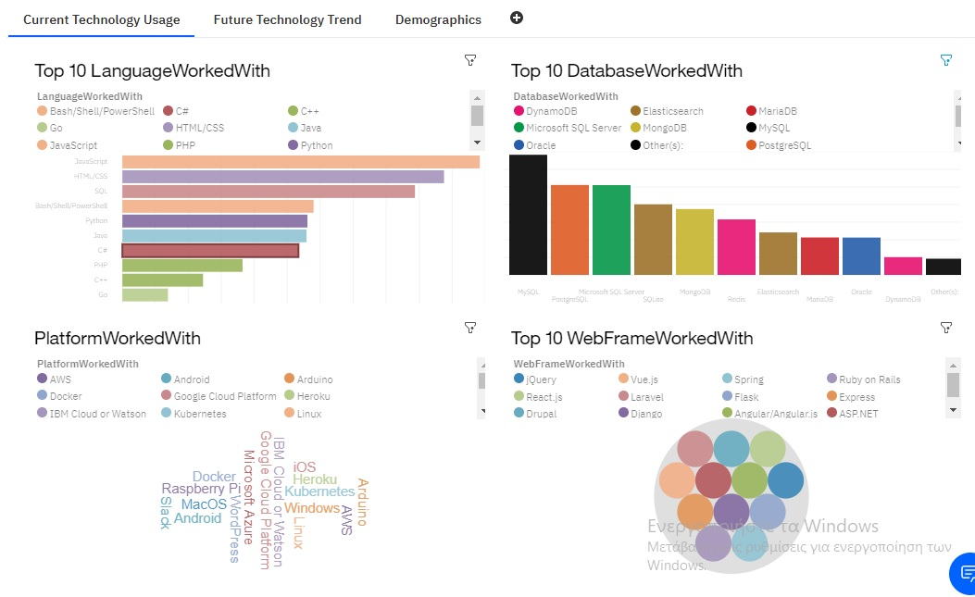
DASHBOARD TAB 1

Slide 13
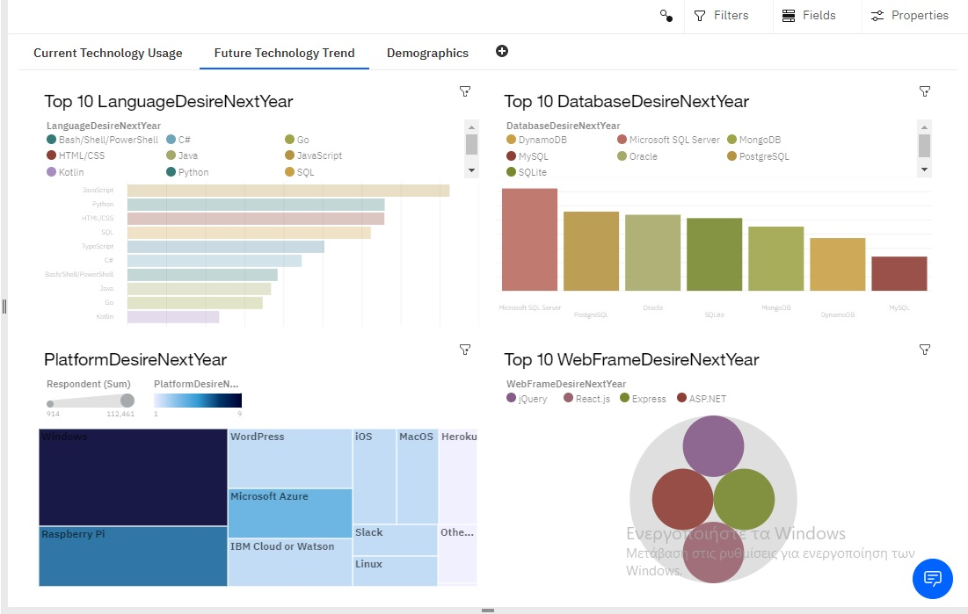
DASHBOARD TAB 2

Slide 14
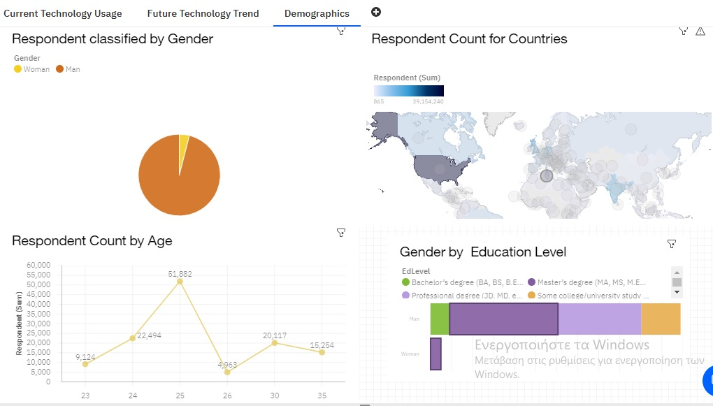
DASHBOARD TAB 3

Slide 15
DISCUSSION
Demographics indicate that IT industry is dominated by the male gender.
From trends it is indicated a growth in AWS and Docker platforms.
PostgreSQL,MongoDB and MySQL are the emerging databases and in most valuable skills for professionals.

Slide 16
OVERALL FINDINGS & IMPLICATIONS
FINDINGS
Increased Trend in Python, PostgreSQL, MongoDB.
Emerging Cloud technologies
Demographic diversification.
Demand for new technology skills for IT professionals.
IMPLICATIONS
Need of constant learning and development of new skills to keep up with trends.
Demand for technology spread around the world.
Knowledge of cloud applications will be highly beneficial.

Slide 17

CONCLUSION
Trends and market indicate a need for professionals in IT to upskill.
Balance in the gender can produce more opportunities for women.
Spread of technology can generate more opportunities globally.

Slide 18
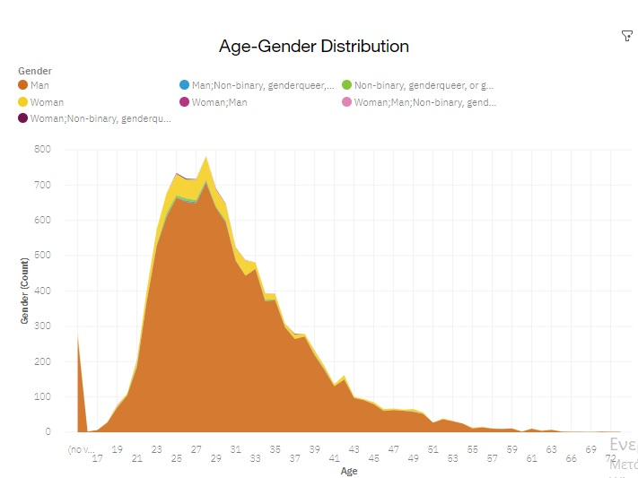
APPENDIX

Slide 19
GITHUB JOB POSTINGS
In Module 1 you have collected the job postings data using GitHub API in a file named “github-job-postings.xlsx”. Present that data using a bar chart here. Order the bar chart in the descending order of number of job postings.

Slide 20
POPULAR LANGUAGES
In Module 1 you have collected the job postings data using web scraping in a file named “popular-languages.csv”. Present that data using a bar chart here. Order the bar chart in the descending order of salary.

